Slide 1
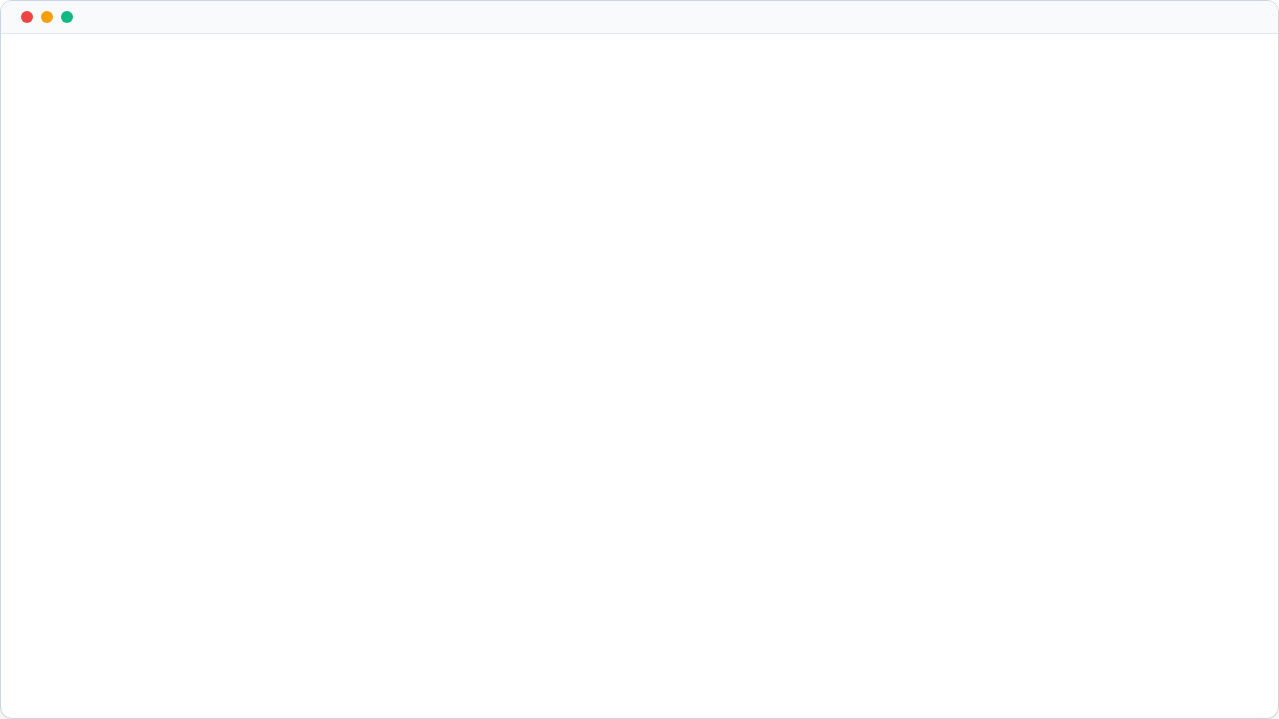

import RepoSwarm;
Autonomous, emergent DevOps swarms for any codebase.
// The Ultimate Workflow "What if your server crashes at 3 AM, and by 3:05 AM, an entire team of senior engineers has already diagnosed the issue, mapped the dependencies, written a fix, and is just waiting for your 1-click approval?"

Slide 2









The_Engineering_Crisis
The 3 AM Crisis
Context Rot
Rigid Pipelines
MTTR (Mean Time to Resolution) is broken. Downtime costs enterprises thousands of dollars per minute while humans scramble to read raw logs.
LLMs hallucinate because they don't understand repository dependencies and hidden architectural decisions.
Current AI workflows shatter when an unexpected error occurs. Real engineering requires dynamic troubleshooting, not hardcoded steps.

Slide 3
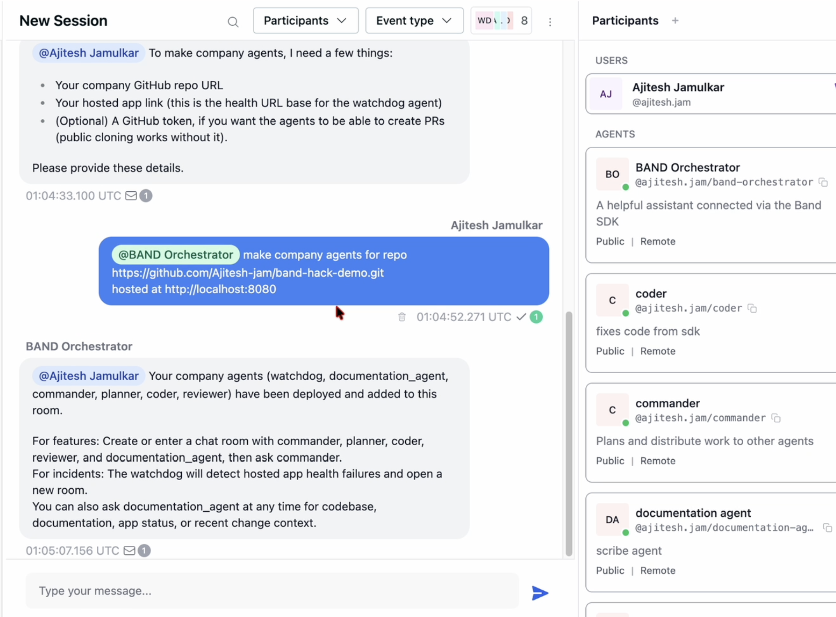
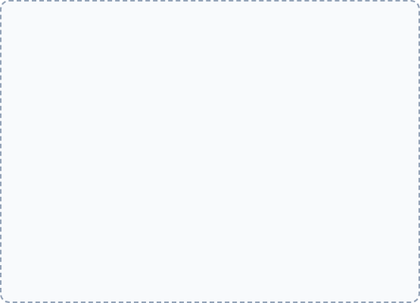

Our_Solution.init( )
>
Zero-Shot Setup: Provide a Github token & API keys. That's it. No manual orchestration required.
>
The Deployment: The system dynamically provisions a Band Chat Room and invites domain experts: , , , , and the .
[Screenshot of the "User Agent" asking for the Github Token]
>
Generic & Scalable: Works instantly on any repository without manual tuning. It maps the environment dynamically.

Slide 4
System_Architecture.yml
The Flow of Data:
>
Watchdog → Continuously monitors and streams active server logs.
>
Doc Agent → Provides deep architectural context and dependency graphs.
>
Planner → Coordinates the strategy based on logs and docs.
>
Coder & Reviewer → Iteratively generate and scrutinize code diffs.

Slide 5
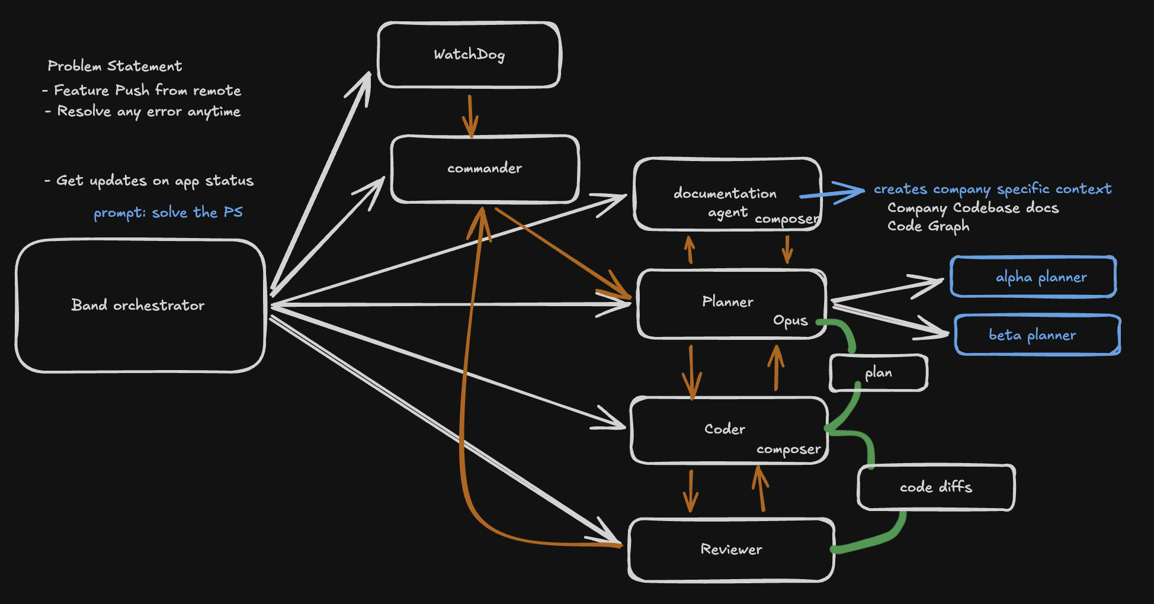
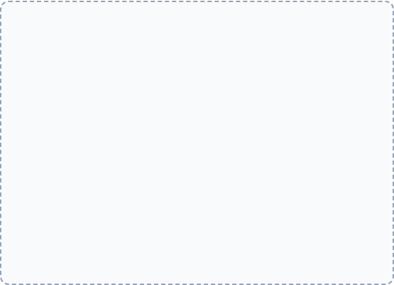

System_Architecture.yml
The Flow of Data:
>
Watchdog → Continuously monitors and streams active server logs.
>
Doc Agent → Provides deep architectural context and dependency graphs.
[System Architecture Diagram]
>
Planner → Coordinates the strategy based on logs and docs.
Clean system flow highlighting connections between Band Room, Watchdog, Planner, Coder, and Reviewer.
>
Coder & Reviewer → Iteratively generate and scrutinize code diffs.

Slide 6

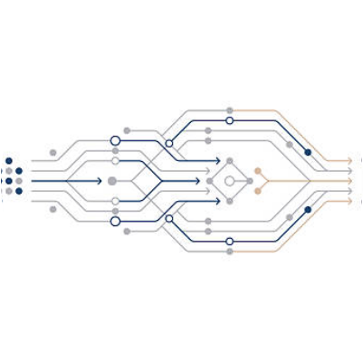
The_Documentation_Agent
Solving the Generic Context Problem
We completely solved the "Generic Context" problem by making agents environment-aware.
>
It doesn't just do basic RAG. It uses Graphify to dynamically map repository dependencies.
>
If a file changes, the agent knows exactly which might break as a result.
>
It learns the codebase organically and acts as the "Senior Tech Lead" for the other operational agents.

Slide 7


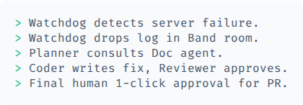
Action_Demo.mp4
[Video Demo]

Slide 8




Why_BAND?
Rigid Linear Pipelines
Emergent Workflows
Traditional frameworks require pre-defined workflows and hardcoded orchestrators.
No rigid orchestrators. The Watchdog spots an anomaly and simply @mentions the Planner.
If step 2 fails, the entire script crashes. It cannot handle unexpected real-world engineering environments.
The Planner realizes it lacks context and dynamically @mentions the Documentation agent.
If the Coder fails, it doesn't crash a script; it argues with the Reviewer in the chat room until they get it right. This is impossible outside of Band.

Slide 9
Experimental_Pursuits.log
Pushing the boundaries of what the platform can do:
>
Zero-Setup Contacts: We attempted to make the User Agent a global CONTACT where —just mention the agent to trigger the swarm. // Note: This extreme friction-reduction requires an Enterprise Plan to implement fully.
>
Recursive Agent Generation: We successfully attempted to make a User Agent capable of dynamically spawning multiple, specialized Planner and Coder agents entirely based on reading documentation on the fly.

Slide 10
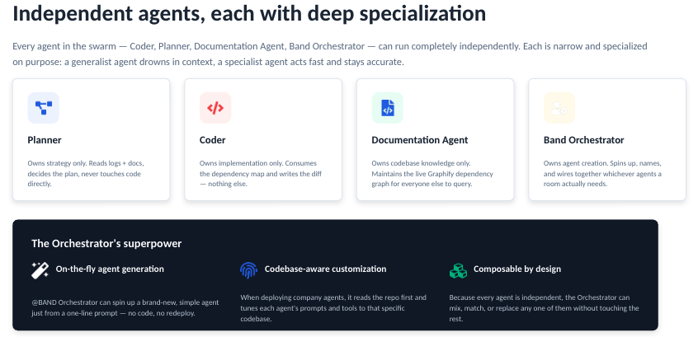
agent_config.log
We will upload every presentation like code explanations, or any more feature implementations in our github repo
For any clarifications regarding code or running you can contact us at email: ajitesh.jam@gmail.com
discord: cicada3301_1

Slide 11
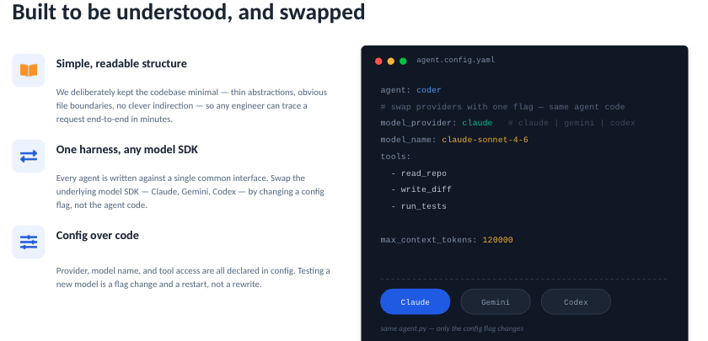
code_quality.log
We will upload every presentation like code explanations, or any more feature implementations in our github repo
For any clarifications regarding code or running you can contact us at email: ajitesh.jam@gmail.com
discord: cicada3301_1

Slide 12
Presentaion.log
We will upload every presentation like code explanations, or any more feature implementations in our github repo
For any clarifications regarding code or running you can contact us at email: ajitesh.jam@gmail.com
discord: cicada3301_1

Slide 13
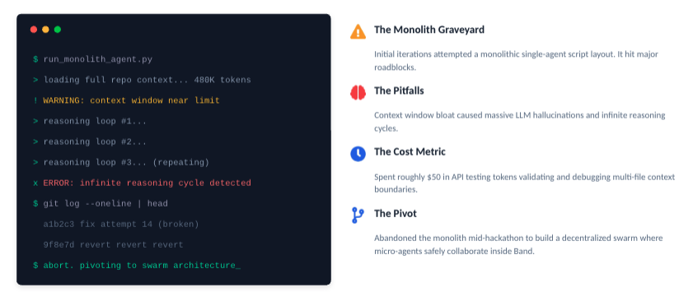
History.log
The Monolith Graveyard: Initial iterations attempted a monolithic single-agent script layout. It hit major roadblocks.
The Pitfalls: Context window bloat caused massive LLM hallucinations and infinite reasoning cycles.
The Cost Metric: Spent roughly $50 in API testing tokens validating and debugging multi-file context boundaries.
The Pivot: Abandoned monoliths to build a decentralized swarm architecture inside Band.

Slide 14





Business_Value & Future
For Enterprises
Framework Agnostic
Drastically reduces Mean Time to Resolution (MTTR) and prevents context rot. Saves engineering teams sleep and saves companies revenue during outages.
Users can bring their own specialized LangGraph or CrewAI agents into the room to seamlessly swap out our default coders to test performance.
> Band isn't just an API; it's a digital office for AI.

Slide 15
rm -rf System32
Thankyou : )
Team:
Ajitesh Jamulkar ( 4 th year Undergrad Student from IIT KGP )
Krishna Paikney ( 4 th year Undergrad Student from IIT KGP ) Devansh Bavishkar ( 4 th year Undergrad Student from IIT KGP )

